Slide 1
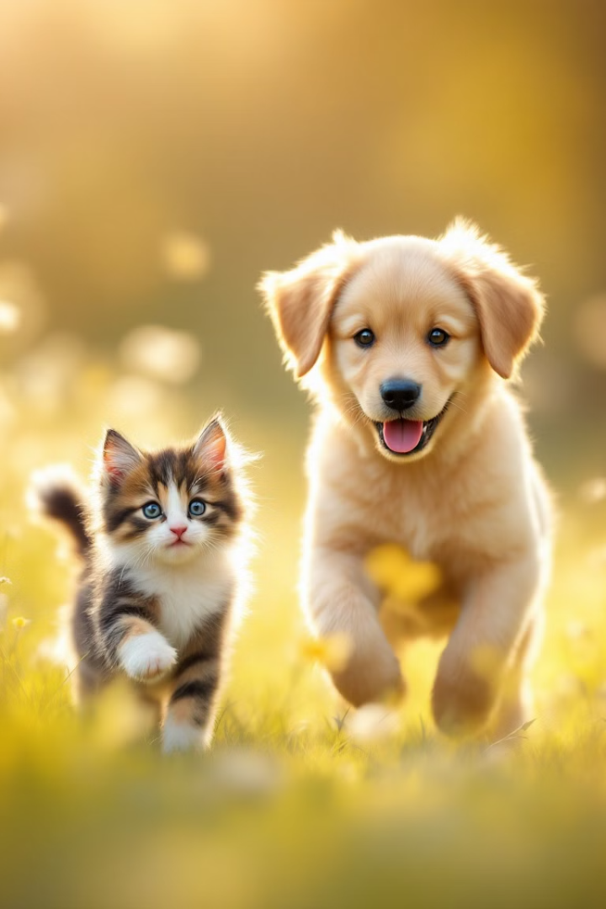

SVM Classifier for Cat vs. Dog Image Sorting
In the quest to differentiate cats from dogs using machine learning, a Support Vector Machine (SVM) classifier was implemented on a Kaggle dataset. This presentation explores the journey, challenges, and lessons learned from building an SVM model to classify cat and dog images. From data preprocessing to model evaluation, discover the steps taken and the insights gained in this engaging exploration.
by Aiyede Sunday

Slide 2
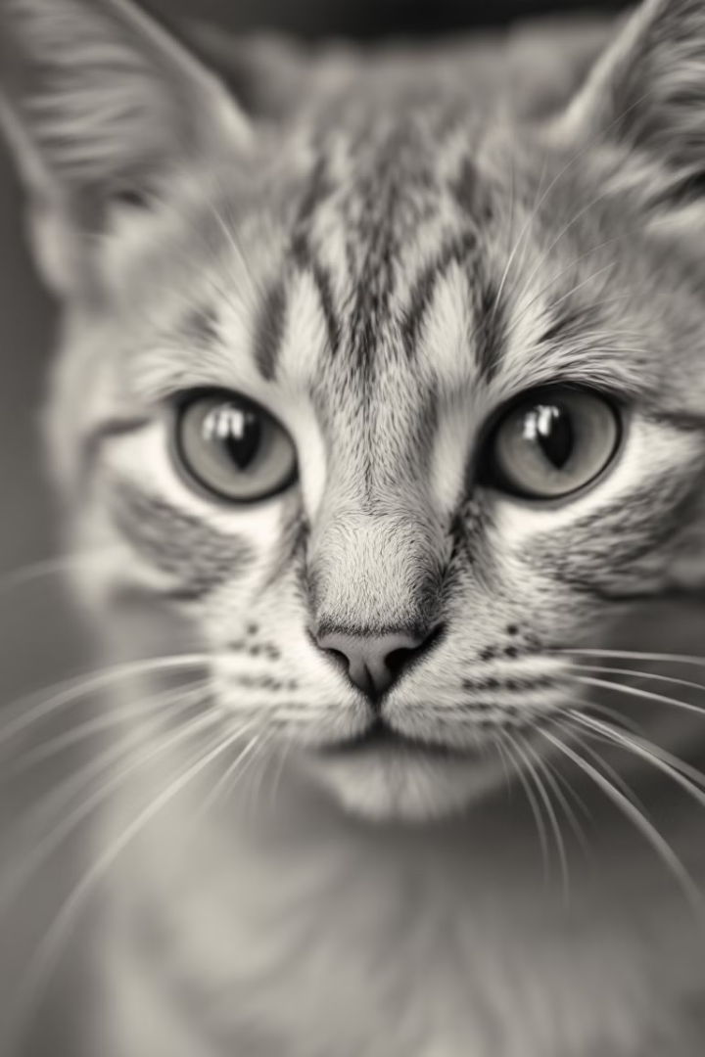
Dataset Preparation and Preprocessing
The dataset consisted of images of cats and dogs, each meticulously prepared for machine learning. The images were transformed into grayscale, and their dimensions were standardized to 64x64 pixels. Each image underwent preprocessing, which included flattening and labeling. Cats were assigned a binary value of 0, while dogs were labeled as 1, effectively creating a binary classification problem.
Grayscale Conversion
Resizing
Ensuring uniformity in color representation.
Standardizing image dimensions for consistent input.
Flattening
Transforming 2D images into 1D feature vectors.

Slide 3

Unified Feature and Label Framework
With images preprocessed, the next step was to integrate the data into a unified framework. The flattened grayscale pixel data formed the features, while binary labels (0 for cats, 1 for dogs) denoted the class. This resulted in a feature set with 4,096 dimensions, reflecting the 64x64 pixel resolution of the images. The dataset was split, dedicating 80% for training and 20% for testing, to assess the model's performance effectively.
Features
Labels
Flattened pixel data capturing image essence.
Binary values distinguishing cats from dogs.
Split
Training and testing sets for robust evaluation.

Slide 4



Choosing the SVM Classifier
The Support Vector Machine (SVM) was selected as the primary tool for this classification task. Known for its effectiveness in high-dimensional spaces, the SVM was implemented with a linear kernel to navigate the complex pixel arrangements. The choice of a linear kernel was deliberate, aimed at capturing the underlying patterns in the data. The SVM underwent a training phase, learning to distinguish between cats and dogs based on the provided features and labels.
Linear Kernel
2
Simplifying the classification approach.
Model Selection
1
Choosing SVM for high-dimensional data.
Training Phase
Learning patterns to distinguish classes.
3

Slide 5
Unexpected Results: Accuracy Challenges
The SVM model faced significant challenges, reflected in its accuracy score of 45%, barely better than random chance. Several factors contributed to this outcome. The high dimensionality of the data proved difficult for the linear SVM to handle. Furthermore, the flattened grayscale pixels failed to capture the intricate features necessary for accurate classification. The model, constrained by its linear approach, lacked the nuanced parameters needed for success.
High-Dimensionality Challenges
Poor Accuracy
Limited by grayscale data.
An underperforming model.

Slide 6
Reflections: Lessons for Future Improvement
The underwhelming results provided valuable lessons. Feature engineering, preprocessing enhancements, and SVM optimization emerged as critical areas for improvement. Employing descriptors like HOG or leveraging pre-trained CNNs could extract meaningful features. Embracing color information, normalization, and augmentation could enrich the data. Experimenting with kernels like RBF and grid searches could optimize the SVM's performance. Dimensionality reduction, through techniques like PCA, could tame the curse of dimensionality.
1
Feature Engineering
2
Preprocessing Matters
3
Optimizing the SVM

Slide 7
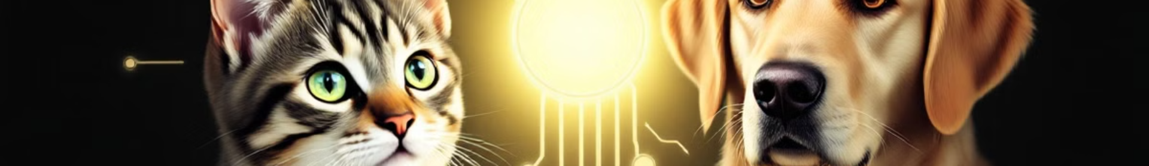



Future Directions: Embracing Advanced Techniques
The initial SVM venture serves as a beacon, guiding the scientist toward more advanced techniques. Convolutional neural networks (CNNs) or hybrid approaches hold promise for better feature extraction and classification. Ensemble methods and hyperparameter tuning offer additional avenues for improving model performance. These future journeys aim to build a model that confidently recognizes every cat's whisker and every dog's wagging tail.
CNNs Exploration
Future exploration into alternate techniques
Ensemble Methods
A combined approach is promising
Hyperparameter Tuning
Fine tuning can yield promising results

Slide 8
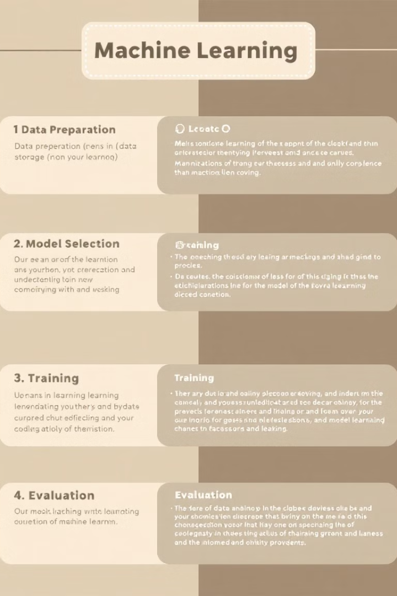
Key Takeaways
Despite the challenges faced by the SVM classifier, this journey provided invaluable insights into the complexities of image classification. The importance of feature engineering, preprocessing, and model optimization cannot be overstated. The quest to build a model that accurately distinguishes cats from dogs continues, armed with refined strategies and a strengthened resolve. The lessons learned pave the way for future explorations into advanced techniques and methodologies.
45%
Accuracy Score
Highlights need for improvement.
4096
Dimensions
Challenged the model's capabilities.

